Slide 1
Chrome Extension for MOOC forum intervention
By Ng Kheng Yi

Slide 2

What’s the need?

Slide 3

1) High amount of students

Slide 4

2) Lack of time (For instructors)
3) Differing urgency for intervention

Slide 5
What’s the need?
Large number of students
Lack of time (For instructors)
Differing urgency for intervention (Between threads)
Requirement to filter threads for intervention

Slide 6
Predicting Requirement for Intervention on MOOC forums
Objective:
Usage of prediction model that learns instructor intervention patterns and predict future interventions
Allow instructors to selectively post on student discussions on forums, scaling interventions

Slide 7
Predicting Requirement for Intervention on MOOC forums
Classifier:
Logit classifier with bag of words + other features
Simple technique to address class imbalance
Features:
Forum type
Discourse cues (Agreements, Affirmations, Appreciations to original post)
Length of thread(Number of words/comments/sentences etc)
Ratio of comments to posts

Slide 8
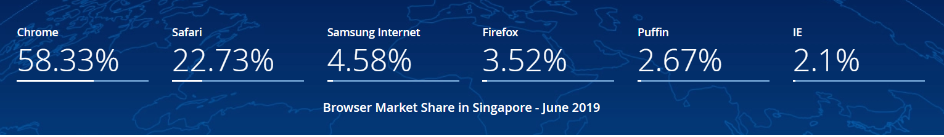
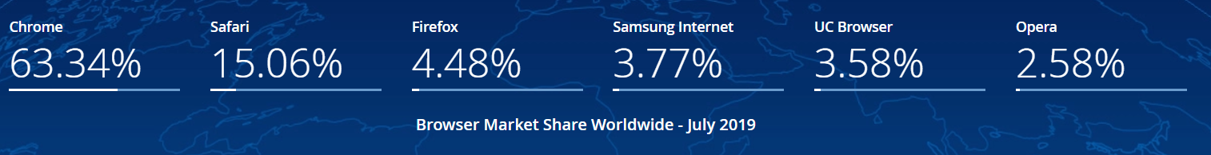
Why Chrome?
*Statistics and Diagrams taken from https://gs.statcounter.com/browser-market-share/all/singapore

Slide 9
Chrome Extension
Modifies forum webpages based on thread information obtained

Slide 10
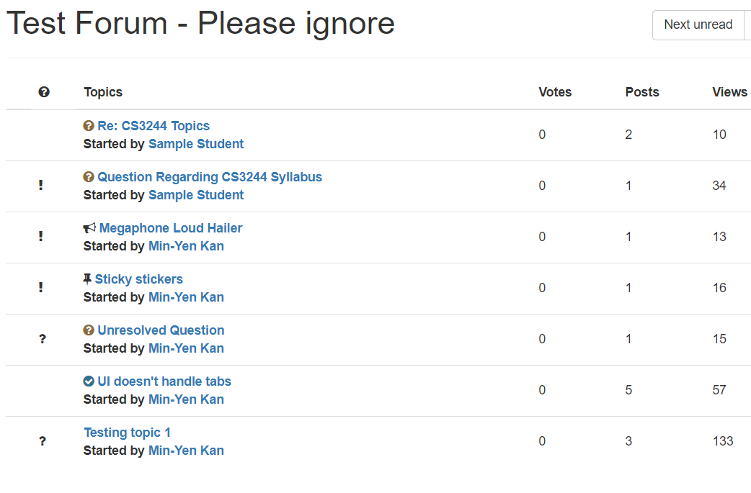
Attention Recommended
Thread yet to be Classified

Slide 11
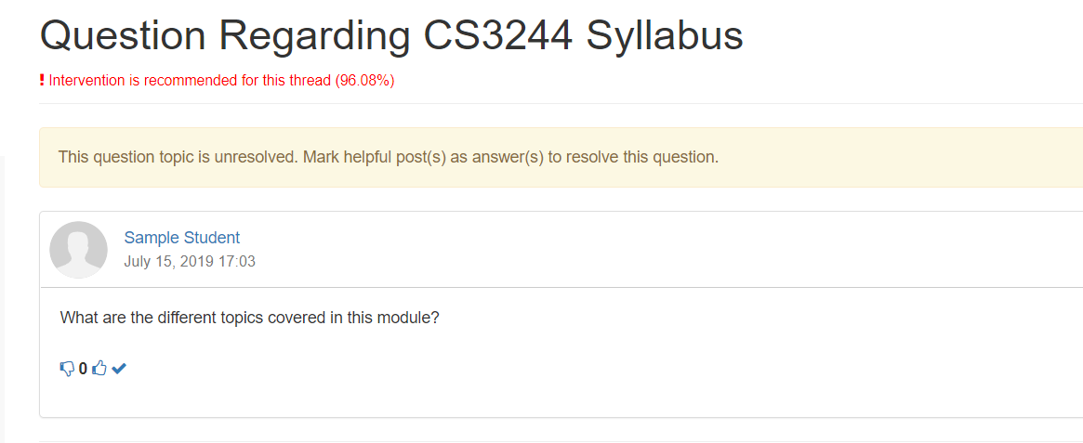
Injected by Extension

Slide 12
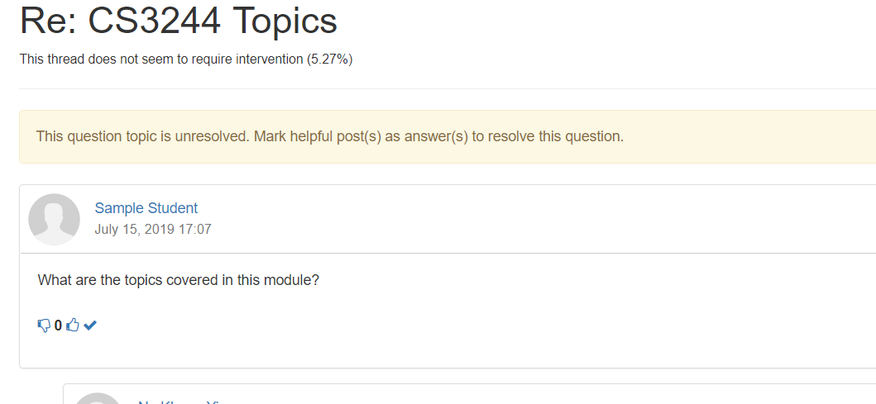

Slide 13






Extension Implementation Architecture – Thread View
User
Storage
Browser
Accesses
Displayed to
Updates display to
Stores Results
Reads from
Script
Frontend
Modifies
Browser Extension
Read API
Sends Thread Data
Receive Prediction
Backend
ML Model
LMS forum Webpage
AWS Lambda
*Icons designed by freepik from www.flaticon.com

Slide 14
Extension Implementation Architecture – Forum View
User
Storage
Browser
Accesses
Displayed to
Updates display to
Retrieves Classification Results
Reads from
Script
Frontend
Modifies
Browser Extension
Read API
Backend
LMS forum Webpage
*Icons designed by freepik from www.flaticon.com

Slide 15
Possible Enhancements
- Pull API to extract thread information
- Extend to other LMS-es (outside of Coursemology)
- Expand extension to function on other browsers (Currently only on Google Chrome).
- Additional features to ease amount of reading required by the instructor
- LMS to implement API to use classifier directly to display results

Slide 16
Suggested Implementation in LMS
User
Browser
Accesses
Displayed to
Removes need for extension
More Efficient
Better integration into existing UI
Frontend
Read API
Backend
Sends Thread Information
ML Model
Sends Classification Results
LMS forum Webpage
AWS Lambda
*Icons designed by freepik from www.flaticon.com

